Slide 1
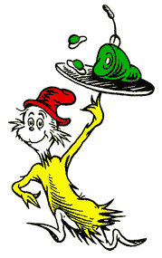
Green Eggs and Ham Graphic Interface Process
By: Sanika Mehta

Slide 2
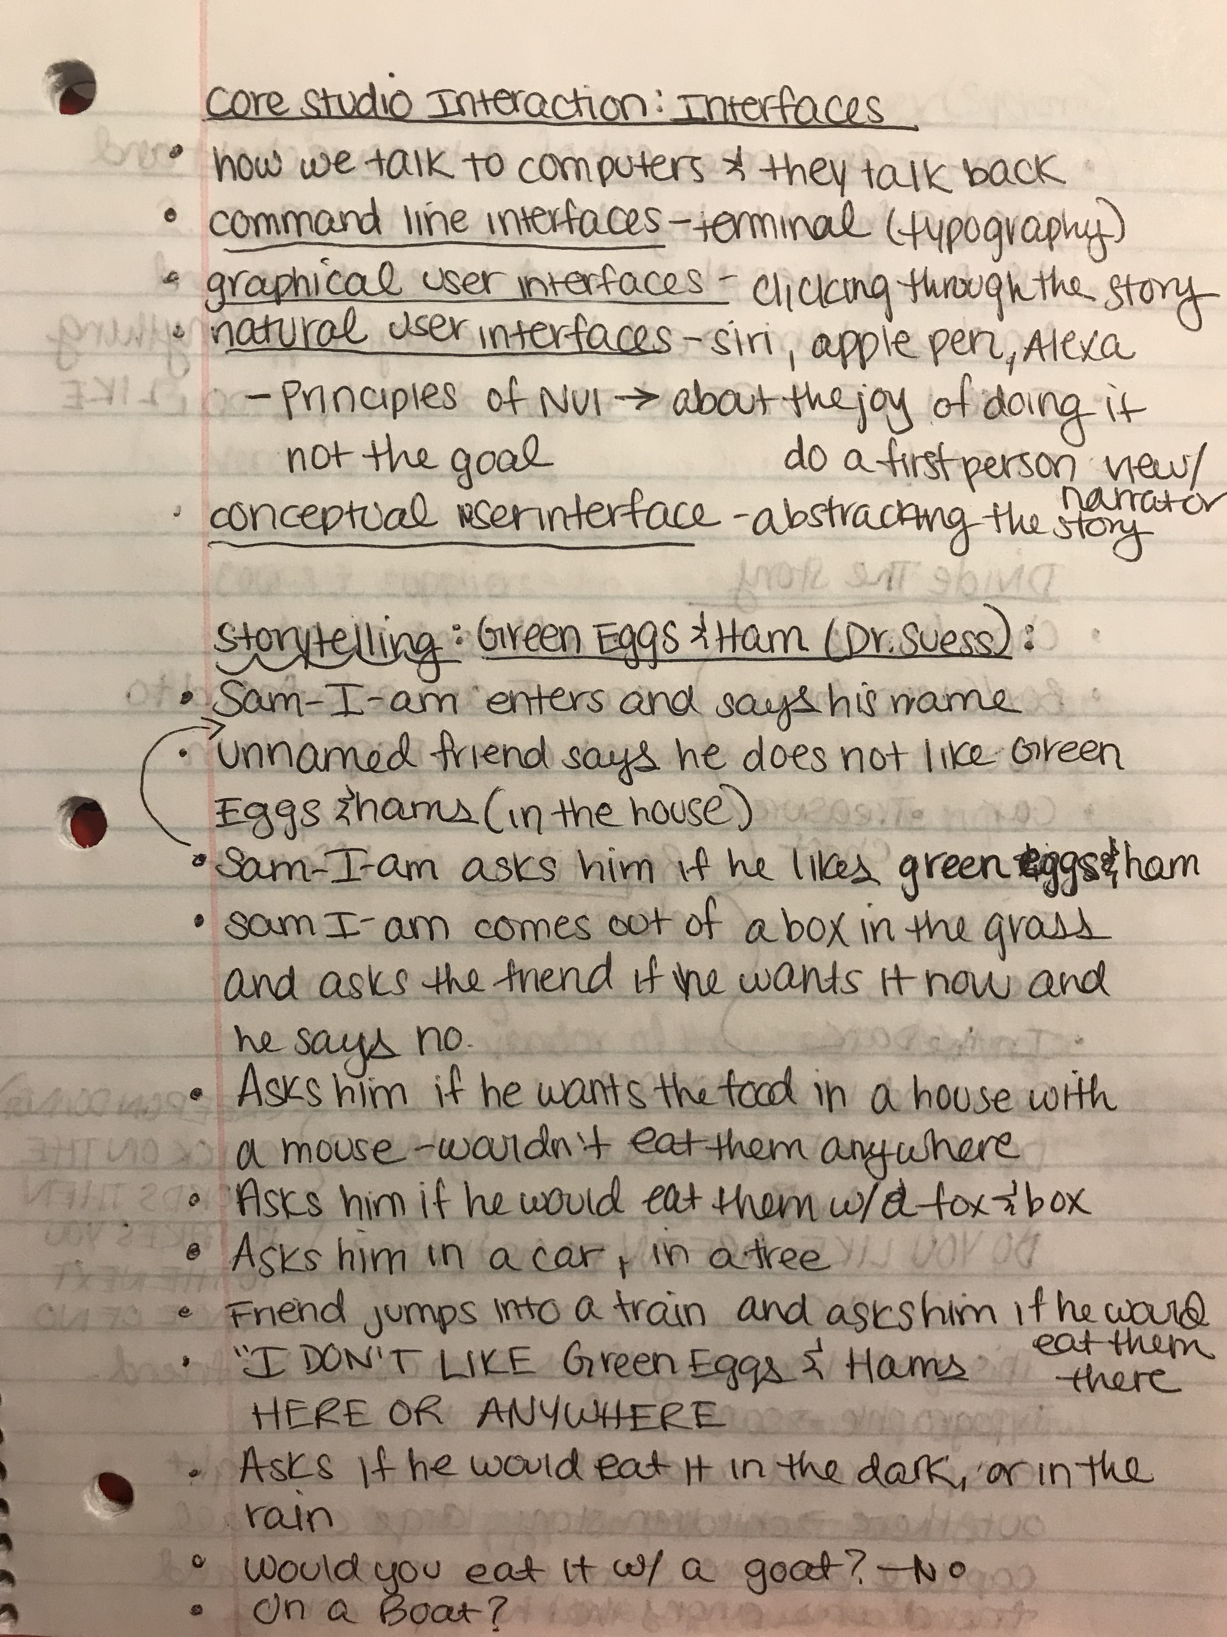
Idea-Story Break Down
This basically goes through the story in simple steps and looks at the repeated patterns and what the overall outcome and message of the story is. Breaks up the story into its different parts.

Slide 3
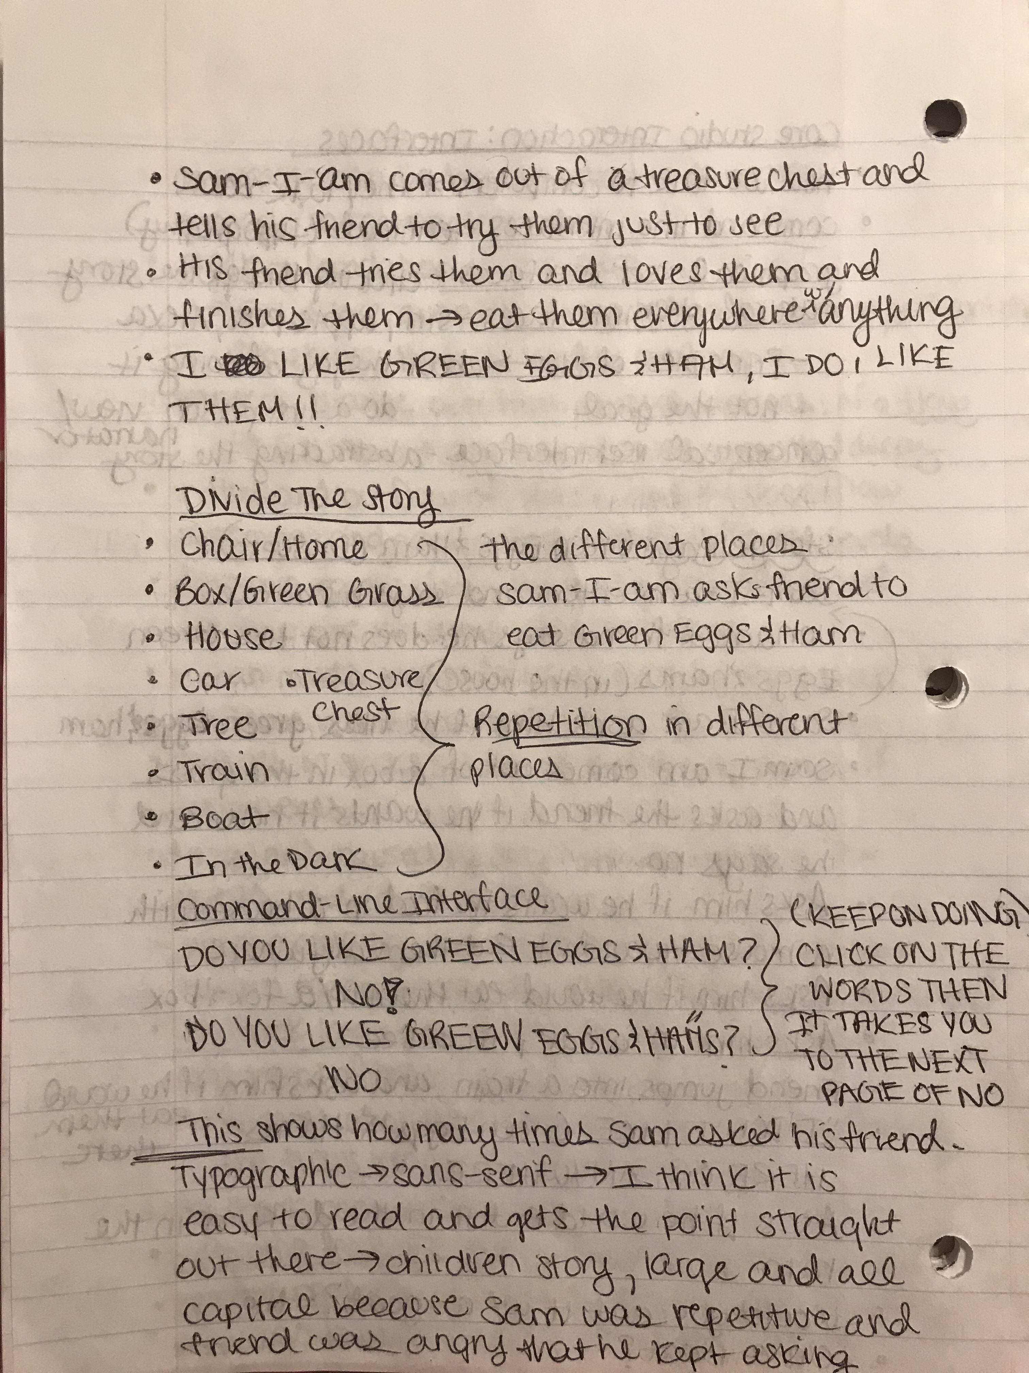
Divide the Story
Decided how I wanted this story to be told by dividing it into the different rhyming sections mentioned in the book.
Different places Sam-I-Am asks the friend ”Would you like Green Eggs and Ham?”
Thought of my typographic choices because I was going to command-line interface too, but then I ended up combining it with the graphic interface idea

Slide 4
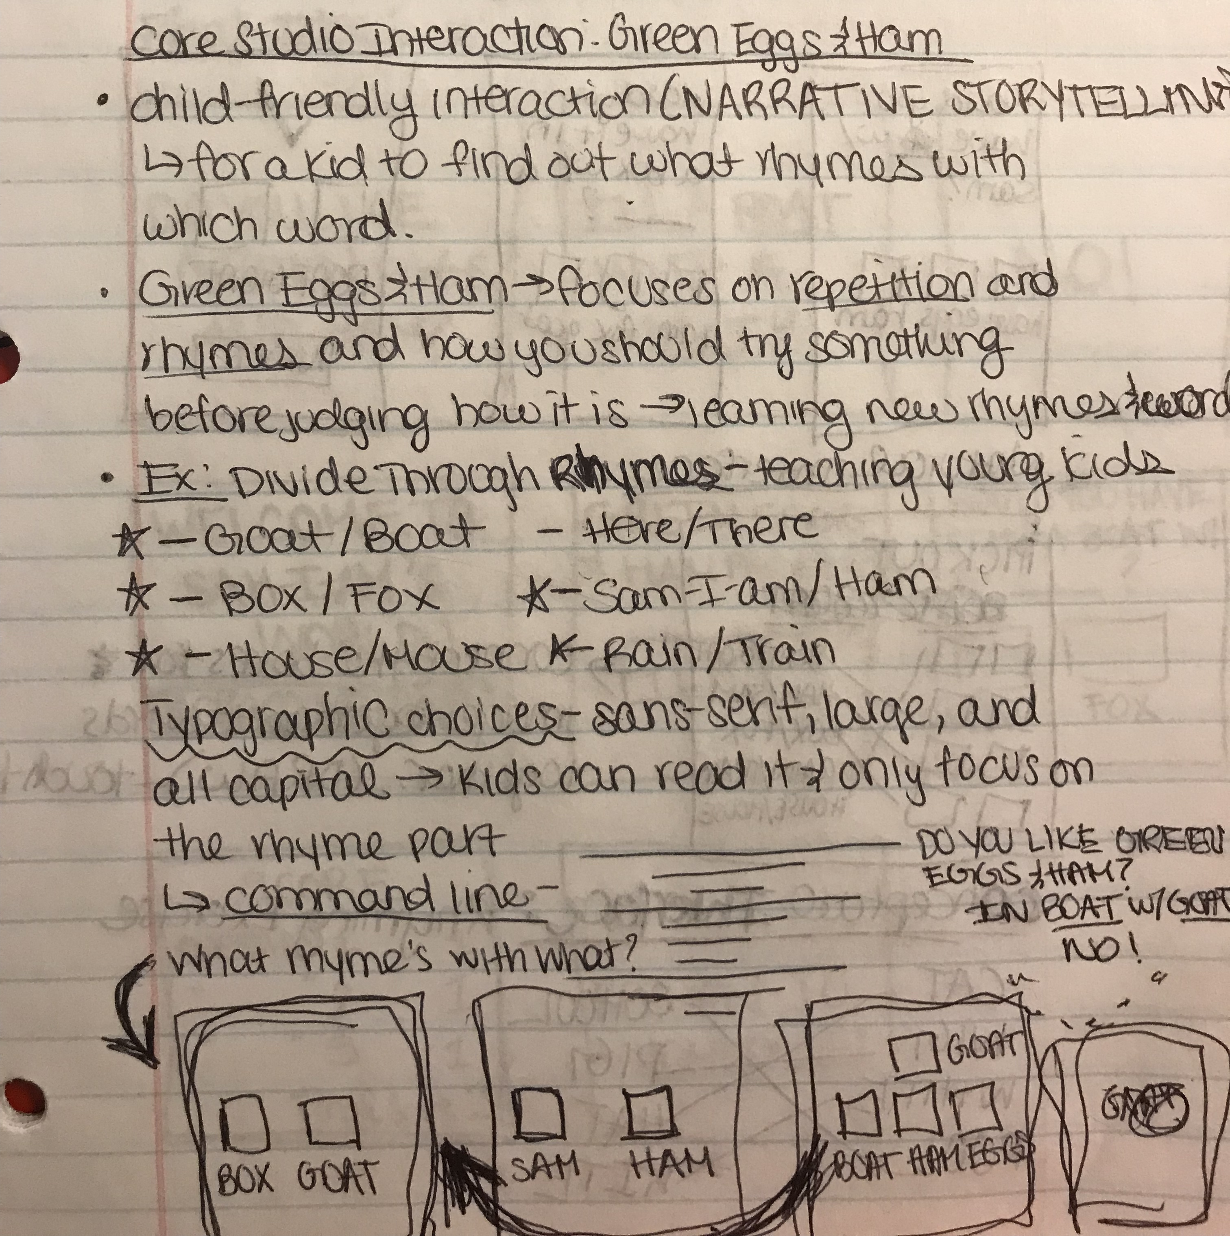
Break Down Final Idea
Finalized what I exactly wanted to do with the story and how I wanted it to be told.
Wanted to create a rhyming game for kids to help them learn what rhyming is and how it relates to Dr.Suess’s Green Eggs and Ham
Split up the different rhymes in the book
Sam-I-Am’s perspective
Typographic choice: kid-friendly and easy for them to read

Slide 5
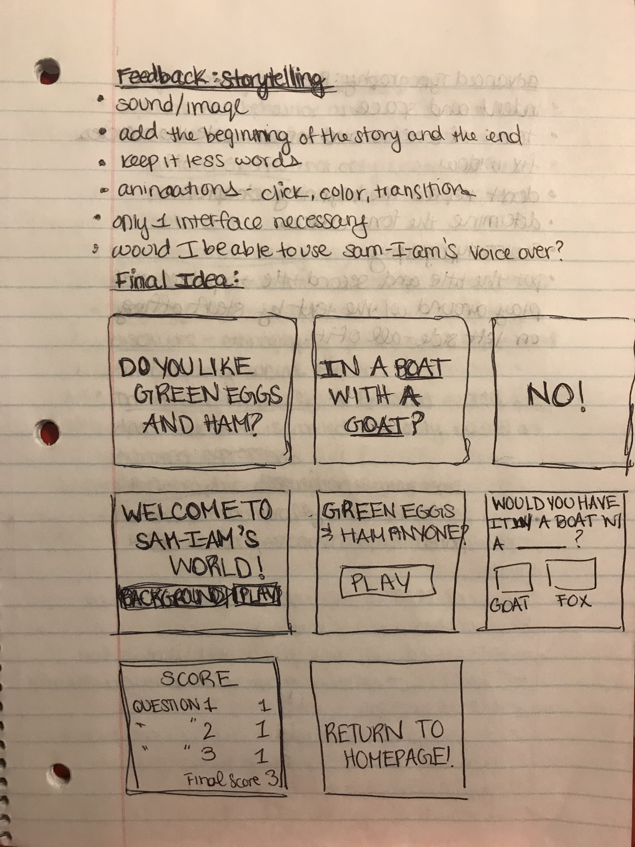
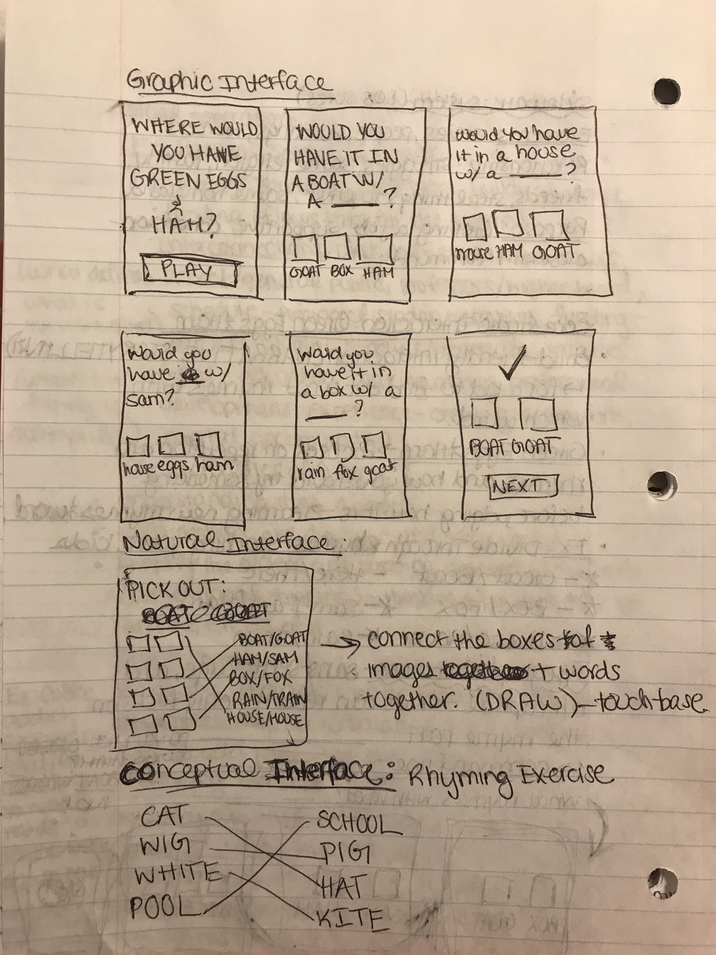
Storyboard-Sample Sketches
Graphic Interface
Command Line Interface

Slide 6
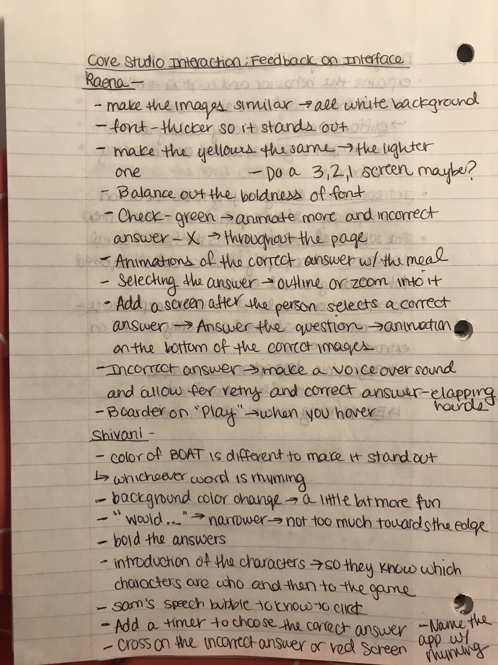
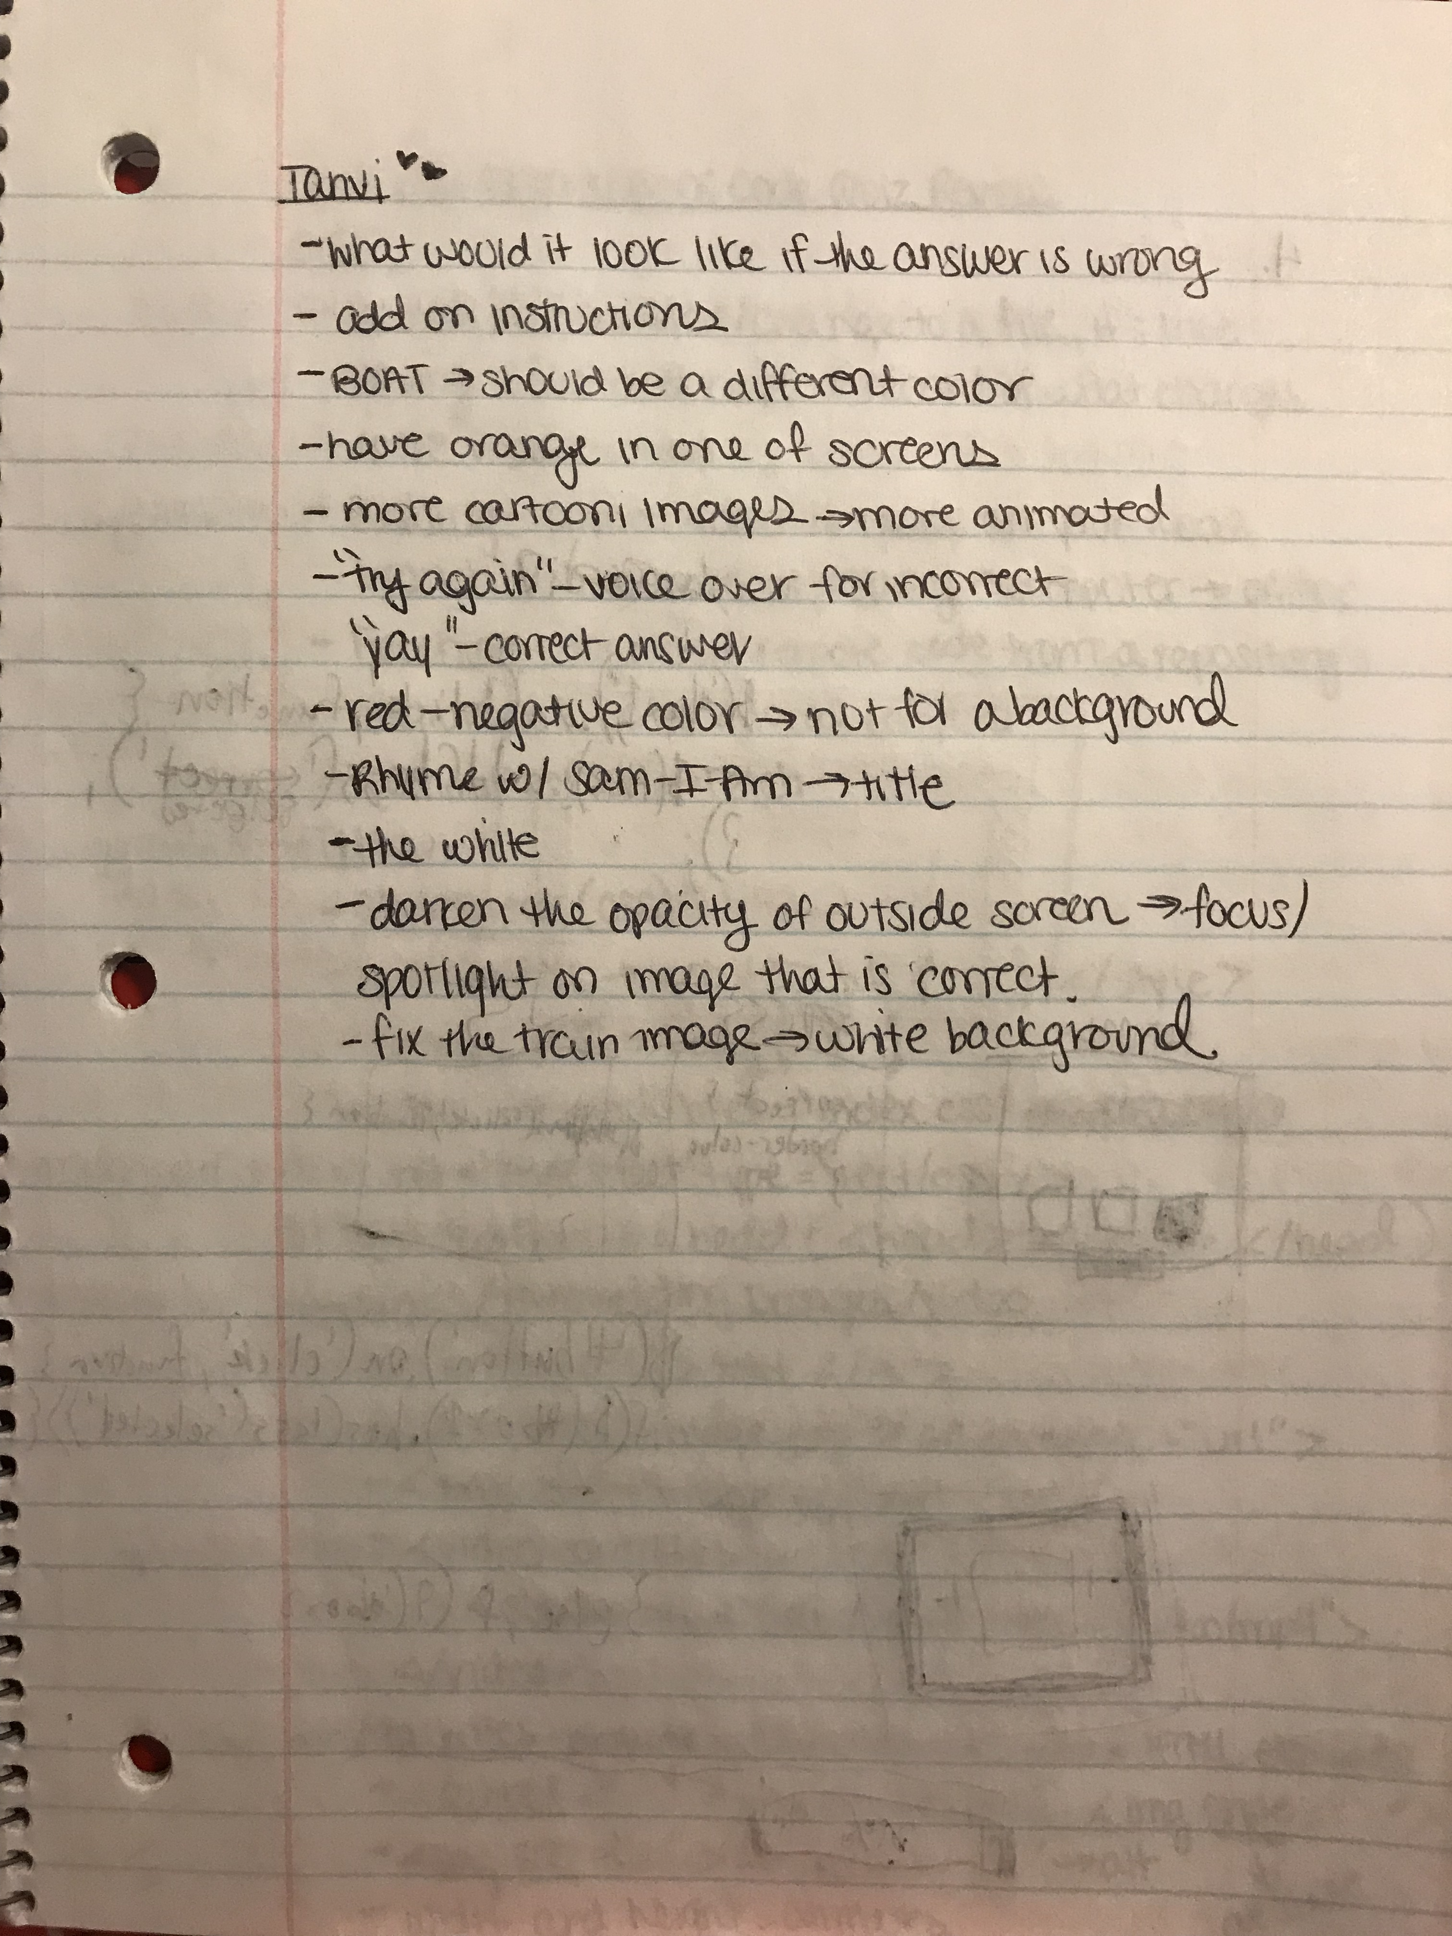
Feedback
Got feedback from three different people(knew Dr.Suess, didn’t know anything about it, knew about Dr. Suess but has never read this book) about my storyboard:
Add in sound effects
Have an instructions page
Keep on changing the background color

Slide 7
Finalize Storyboard
I didn’t actually storyboard the final look of the graphic because I played around with it while I started coding
Took a lot of the feedback points into consideration-added sound effects, additional pages for more clarity, made it look a lot like the book
For example, I didn’t like my typeface, so I ended up changing it to look more like the text of Dr.Suess’s books
Added in different colors for the different pages and figure out how the images would be placed and look similar
I ended up not doing the command line interface because there was a lot of unneeded repetition and there was a way I could include that into my graphic interface
To make it more interactive and kid-friendly, I added in sound effects, transitions, and animations

Slide 8
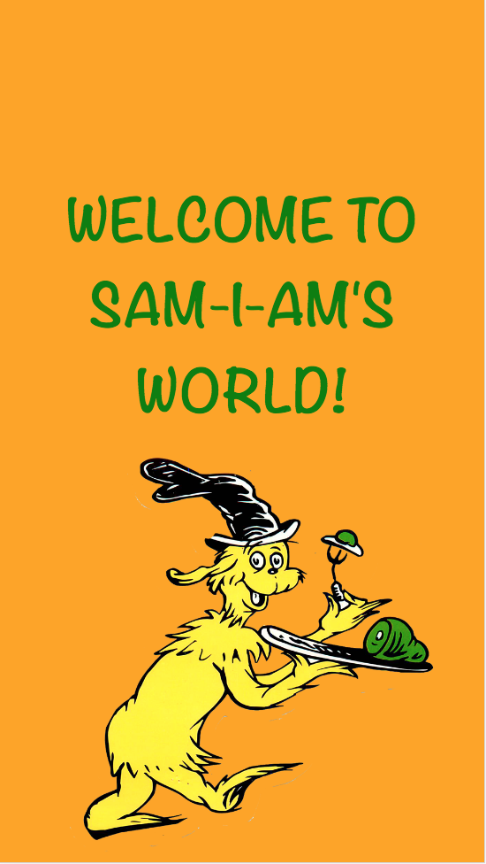
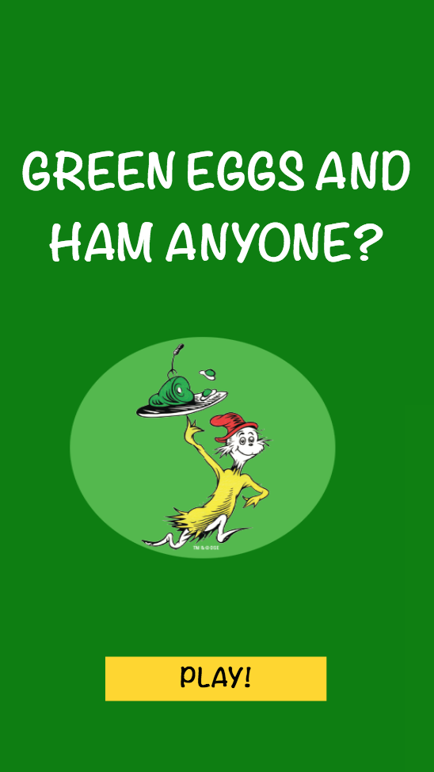
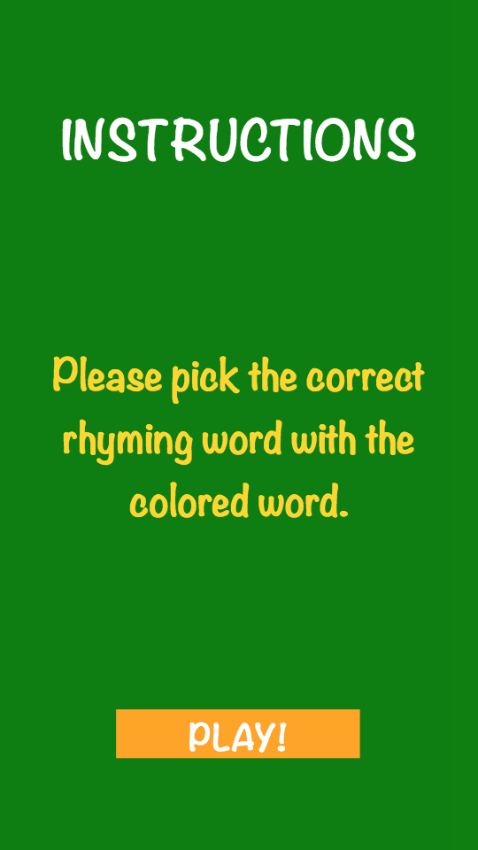
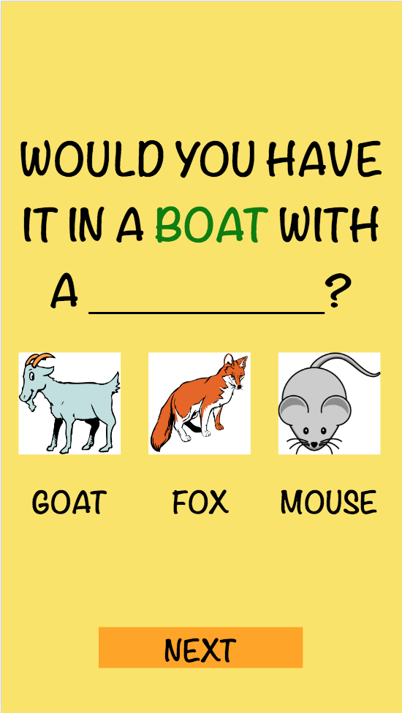
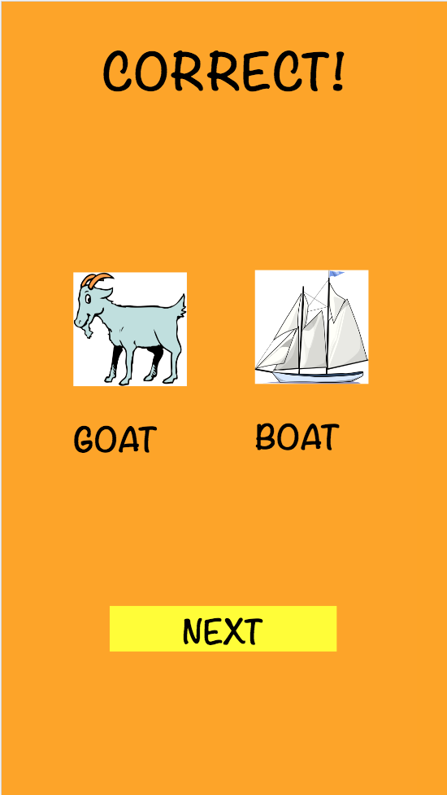
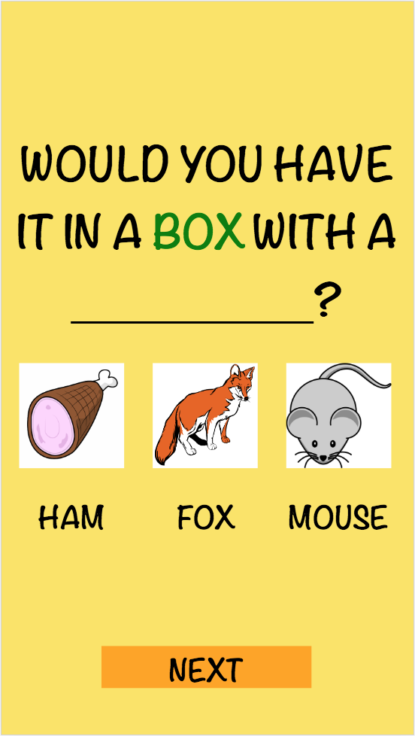
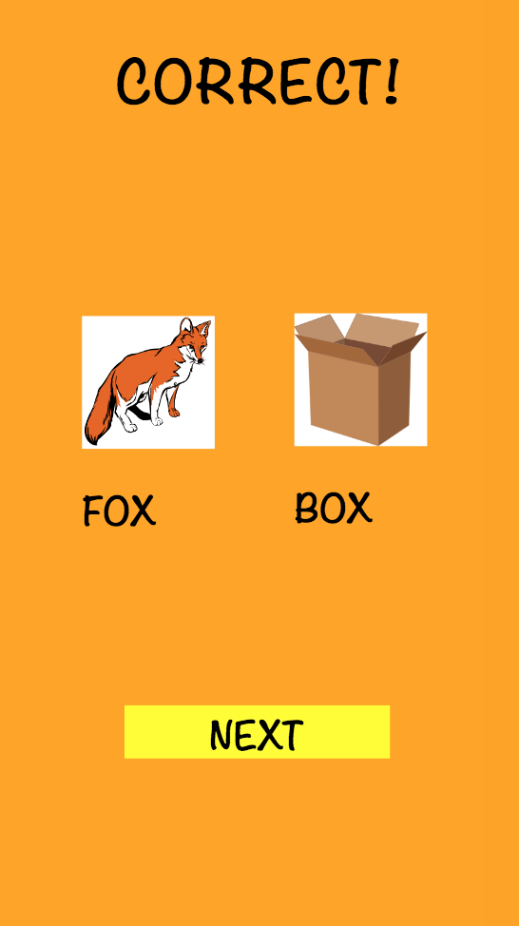
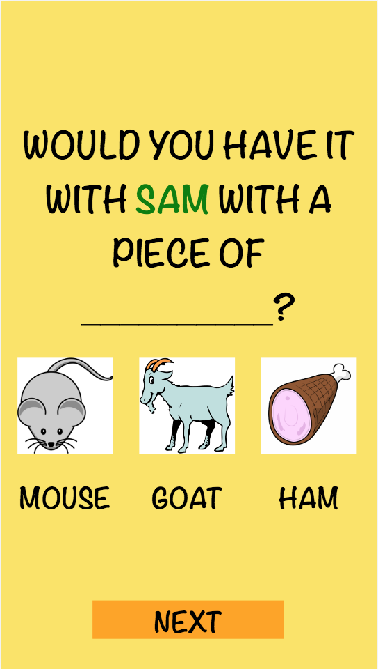
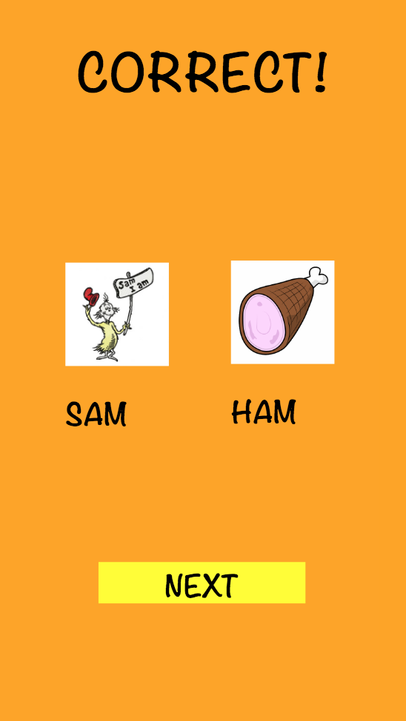
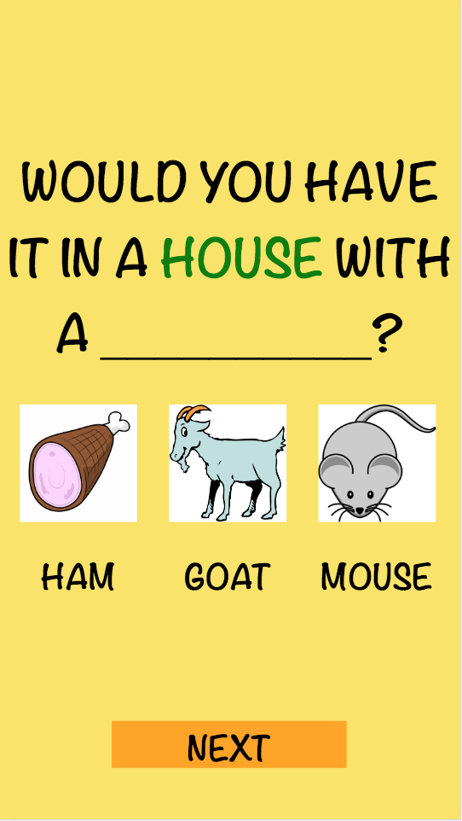
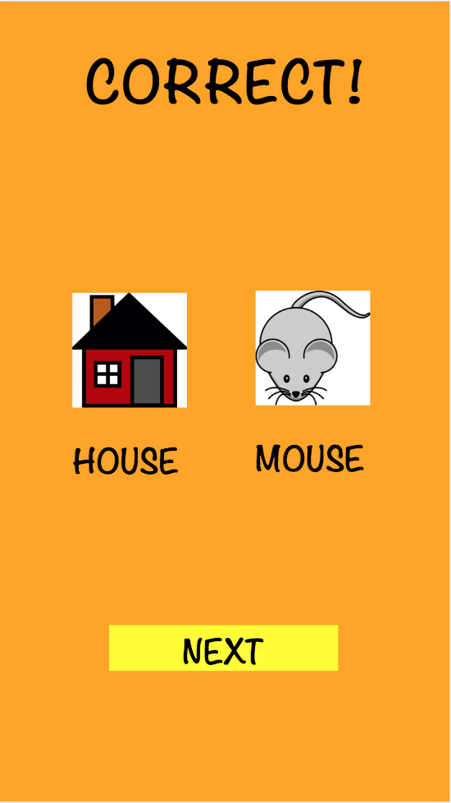
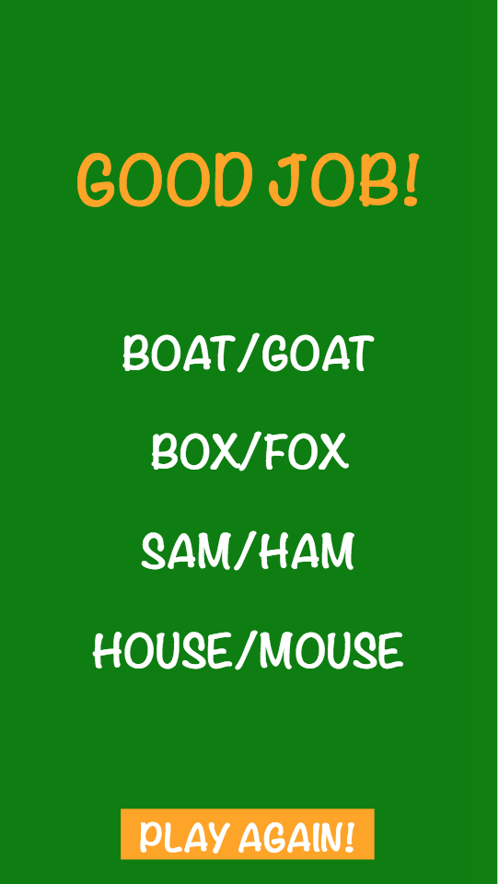
FINAL FLOW

